Slide 1
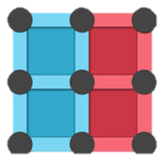
Dots & Boxes
Sunny Kim, Hersh Patel, Cal Garcia

Slide 2
Game Description
We have decided to create a game for our graphics project, Dots & Boxes. The game uses graphics in order to create the grid and allow colors to be used in order to represent each player.
Our Goal
For this game, our goal is to create a 4x4 version of Dots & Boxes using C++. The overall goal was to collaborate as a group in order to create a fully functioning game using our knowledge of C++ that we learned throughout the school year.

Slide 3
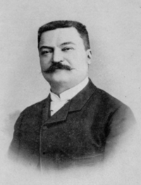
History
Dots and Boxes is a pencil and paper game for two players. It was first published in the 19th century by Édouard Lucas, who called it La Pipopipette. Lucas was a French mathematician who also created the Lucas Sequence responsible for constant-recursive integer sequences that satisfies the recurrence relation. Lucas studied the fibonacci sequence in order to create the Lucas sequence.

Slide 4
Our journey
We have made great strides in our project. We have developed the main screen for the game as well as the main interface and look of the game. Now we are working to get the score counter to work as well as being able to the play the game with a mouse which only partially worked.

Slide 5
Limitations
On our way to creating our game, we faced many challenges that we needed to overcome in order to create our game. Ultimately most of our problems were solved except complications in the game such as the scoreboard and player's turn indicator.

Slide 6
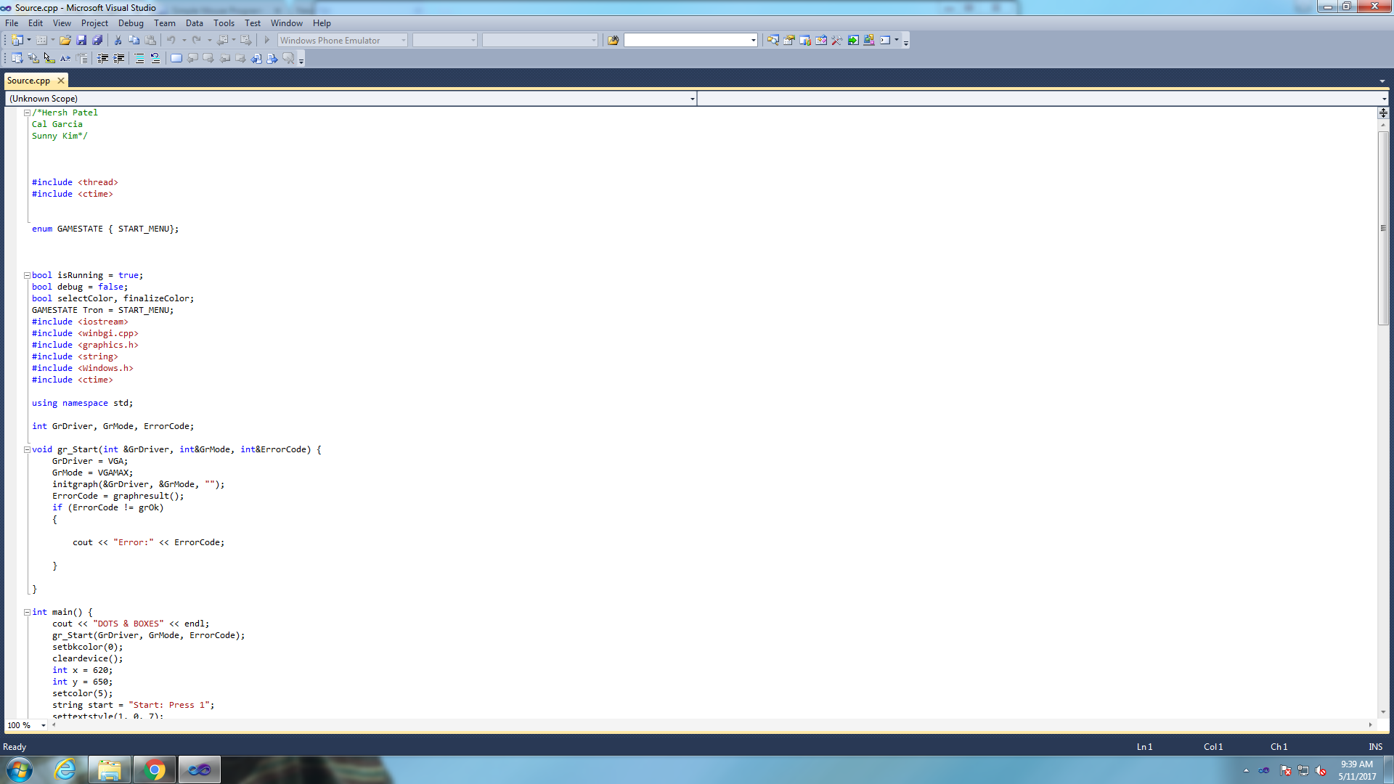
Pictures of our game and code

